Slide 1

Consolidated Status Report
Project Status Report
UAT Group
UAT Portfolio
UAT
1.1
Unus
Unus-Aug
UPL
V1.1

Slide 2
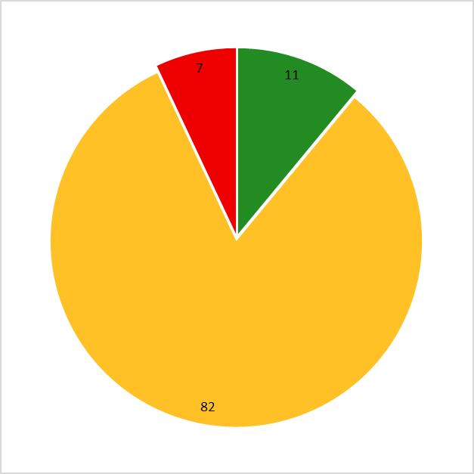
Consolidated Status Report
MSFC
Default Vers...
UAT Project Disabled
Default Vers...
Test quarter 1
1.1
Power BI
1.0.
UAT
1.1
RGen Project123
1.2
Agile Testing
V 1.0
Agile Testing 001A
V 1.1A
test1
1
MBI
1.0
RGen Project123
1.1
Test Step(s) Statistics:
RGen Project123
1.2
Pass:
MBI
V1.0
11
Executed:
Fail:
UAT
1.1
9
Active Testers:
3
Not Completed:
UPL
156
V1.1
Total:
176
Notes:
Active Testers: Number of Testers who has performed Testing with the selected 'Date Filter' criteria.

